Slide 1






Study Buddy
Designed by Anika, Glen, Jasmine and William

Slide 2

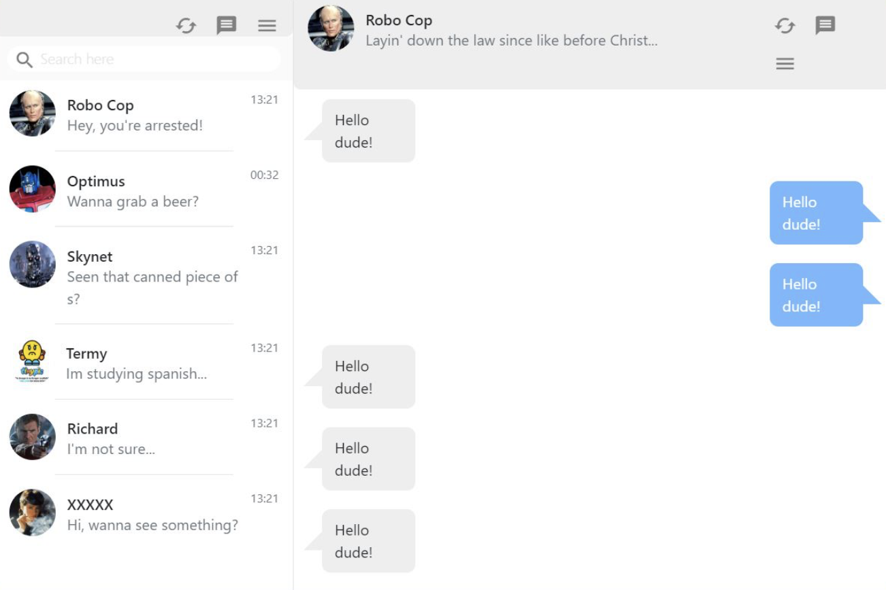
Study Buddy
We are aiming to create software that will match students together based on criteria such as paper selections, strengths and weaknesses in their classes, and potentially other factors such as age and gender. Allowing them to create chat groups, book study rooms and connect.
Notes:
Will need a new photo the texts are innapropriate

Slide 3


We believe that this software will help establish communities of students where they are able to engage and study together. As well as students having the ability to find and match with tutors to achieve their study goals.

Slide 4
Feasibility Report
STUDY BUDDY
Technical
Expertise
Technical Tools
Operational
Logistics
Time Management
Schedule
Time Management
Attendance
Resource
Available Resource
Required Resources
Financial
Cost consideration

Slide 5

Technical
Expertise: The team possesses sufficient expertise, being third-year students with experience in various programming languages and exposure to IT companies.
Technical Tools: Proficiency in Java, HTML, and CSS ensures the team can effectively develop the required functionalities.

Slide 6
Operational
Logistics: The team has the necessary resources and capabilities to execute the project, including access to required technologies and tools.
Task Management: Through using Trello board for task delegation and sprint planning we are ensuring efficient project management.

Slide 7
Schedule
Time Management: With efficient delegation and commitment, the team has plenty of time to achieve project goals within the allocated timeframe.
Attendance: Regular class and SCRUM meeting attendance is emphasized to ensure consistent progress and collaboration.

Slide 8
Resource
Available Resources: The team has access to essential resources such as internet connectivity, tutors, and guidance from Daniel, INFO310’s lecturer.
Required Resources: The project requires a backend database for storing user profiles, which can be acquired within the available resources. We will also require a matching algorithm for matching users with appropriate study buddies.

Slide 9
Financial
Cost Consideration: Leveraging open-source technologies minimizes financial burden, ensuring cost-effectiveness throughout the project's lifecycle.

Slide 10
Feasibility Report
STUDY BUDDY
Based on the assessment, StuddyBuddy demonstrates strong feasibility across technical, operational, schedule, resource, and financial aspects. The team's expertise, logistical capabilities, time management strategies, resource availability, and cost-effective approach support the successful execution of the project. With proper planning and execution, StudyBuddy is set up for a successful outcome and execution.

Slide 11
Timeline
Words words words
Words words words
Words words words
Words words words
Words words words

